Slide 1
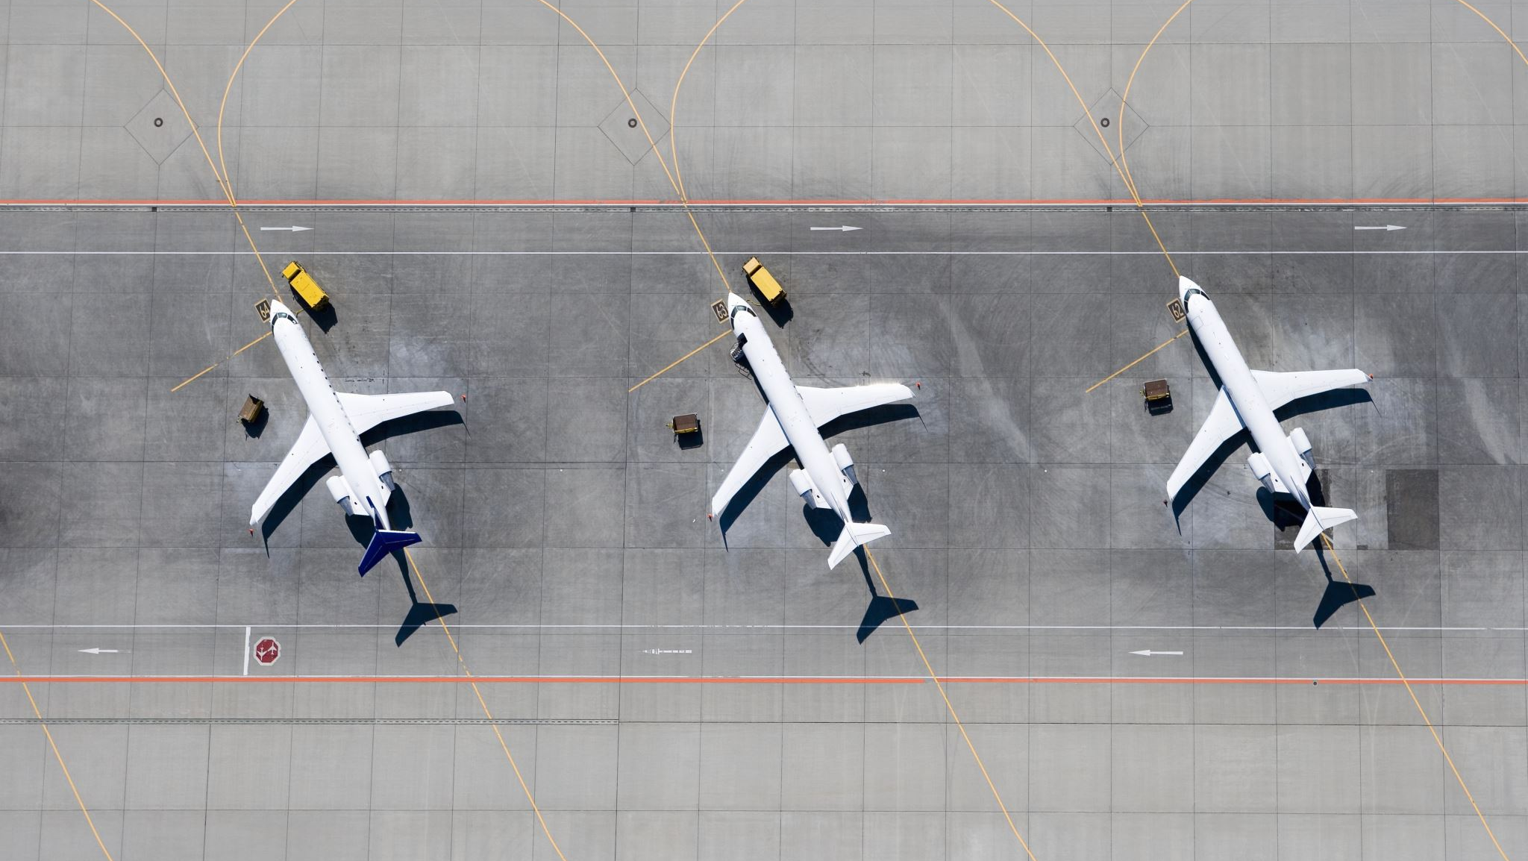
Air Traffic Incidents 2000-2022
Ben MacDonald, CW2
Notes:
Good afternoon, my name is Ben MacDonald and I will be presenting my analysis on Air Traffic Accidents from 2000 to 2022

Slide 2

Intro
Dataset:
Individual aircraft incidents and associated factors
Data Types:
Categorical (required significant cleaning to be useable)
Exclusions:
Ground casualty figures (most were purely coincidental)
Flight Types:
Passenger, cargo, private, military

Slide 3
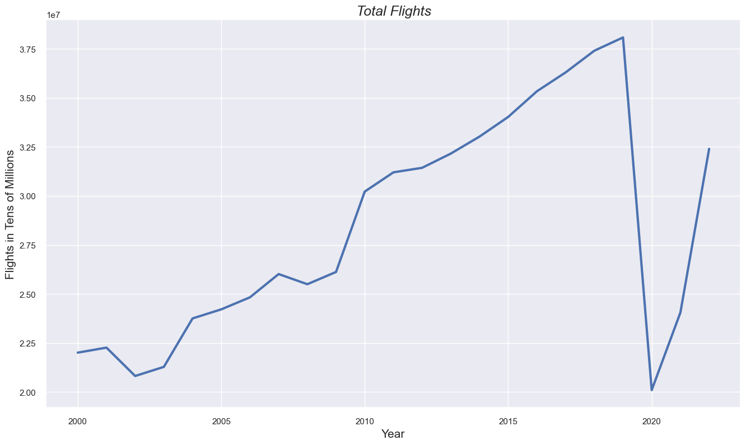
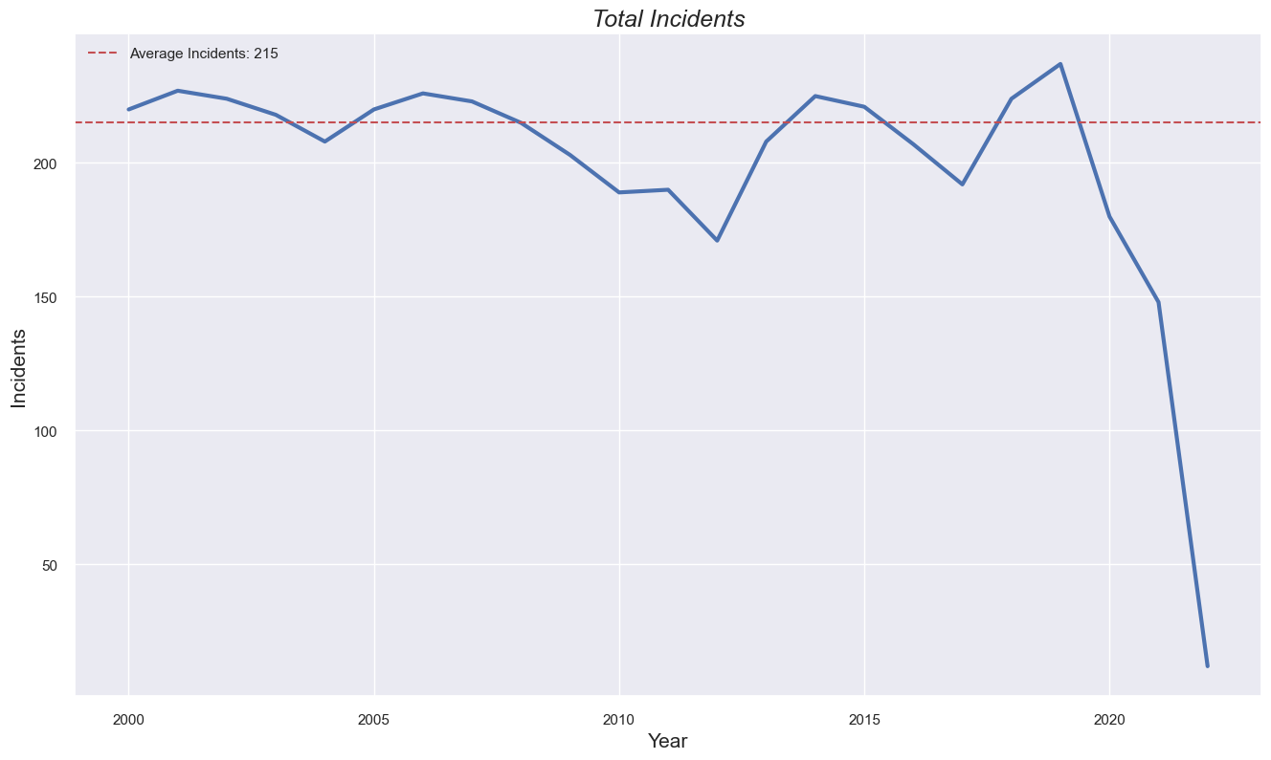
Air Traffic Incidents by the numbers
Covid-19
Covid-19

Slide 4
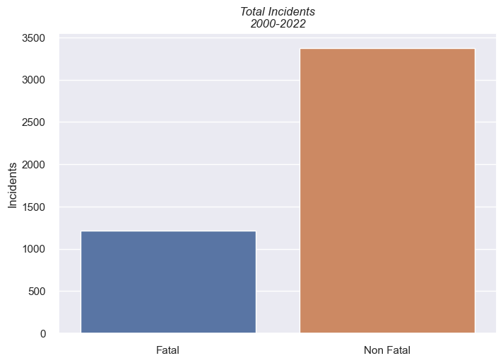
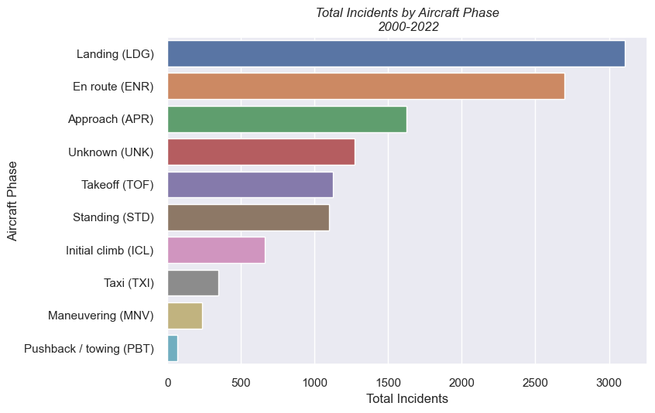
Air Traffic Incidents by the numbers
73.6% of incidents were not fatal
26.4% were fatal
Most incidents occur during flight and landing phases

Slide 5
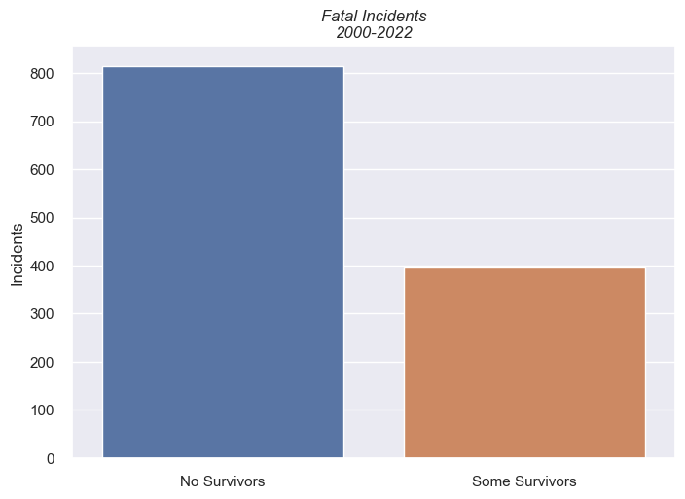
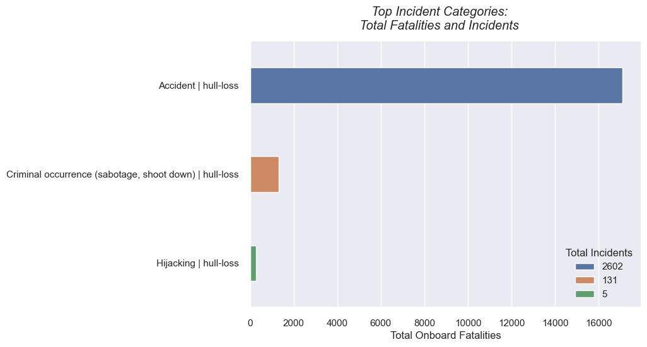
Air Traffic Incidents by the numbers
67% of fatal incidents had no survivors
33% had some
Most incidents were categorized as accidental

Slide 6
Hypotheses
Null:
Incident causes have no influence on fatal occurrences
Alternate:
Incident causes have a significant influence on fatal occurrences
Notes:
I chose to use Individual incident causes as my feature variables and a binary value indicating whether the incident was fatal as my target variable for model training and hypothesis testing.

Slide 7
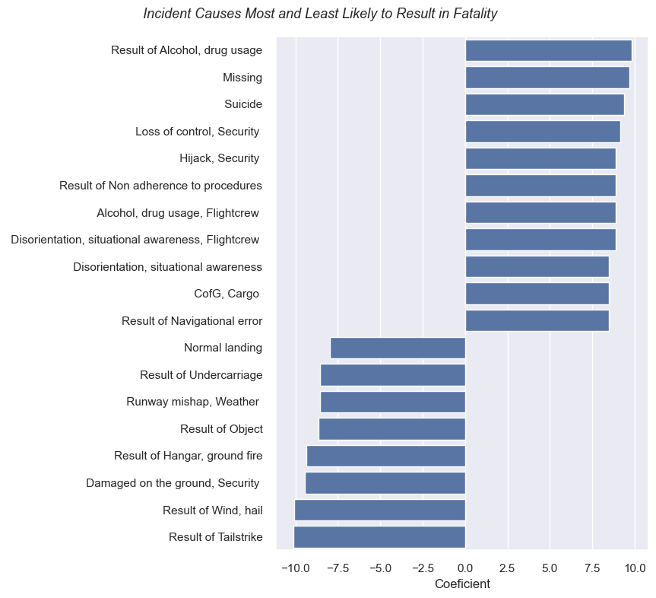

Hypotheses revisited
Most Likely
Null:
Incident causes have no influence on fatal occurrences
Alternate:
Incident causes have a significant influence on fatal occurrences
x
Least Likely
Notes:
I used the Chi squared test to test my hypothesis and found that the p-value was significantly smaller than my 5% threshold. This led me to reject the null hypothesis and accept my alternate hypothesis. I then trained a logistic regression model using my feature and target variables and found a strong predictive relationship between individual incident causes and fatal or non-fatal incidents. On the graph to the right you can see the strongest coefficients from my model. On the top are the causes that had a positive coefficient and show a strong relationship with fatal incidents. And on the bottom of the graph you can see causes with the lowest coefficients which indicate a strong relationship with non-fatal incidents.

Slide 8

Key Findings
Air travel is very safe
Most accidents do not result in fatalities
When there are fatalities, there tends to be a total loss of occupants
Incident causes are a statistically strong predictor of whether an incident will result in fatalities or not

Slide 9

Information
GitHub Repository:
https://github.com/b-macd/Air_Travel_Safety_Analysis
Datasets:
https://www.kaggle.com/datasets/deepcontractor/aircraft-accidents-failures-hijacks-dataset
https://data.worldbank.org/indicator/IS.AIR.DPRT
Contact:
benjamin.t.macdonald.mil@army.mil

Slide 10
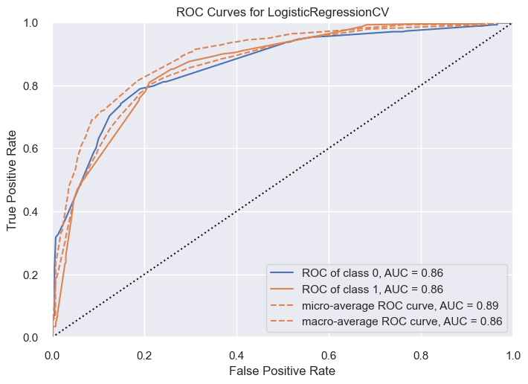
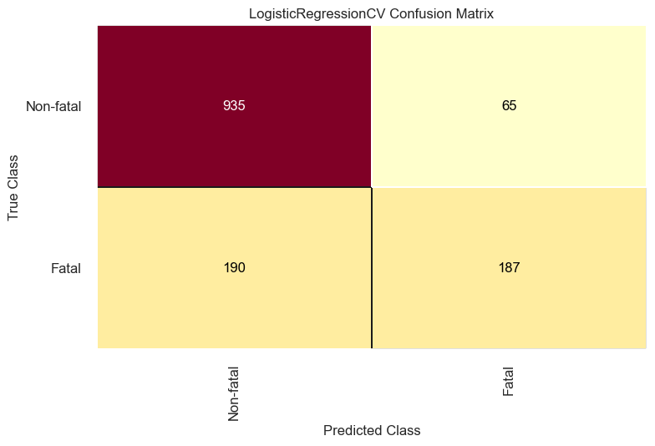
Appendix

Slide 11
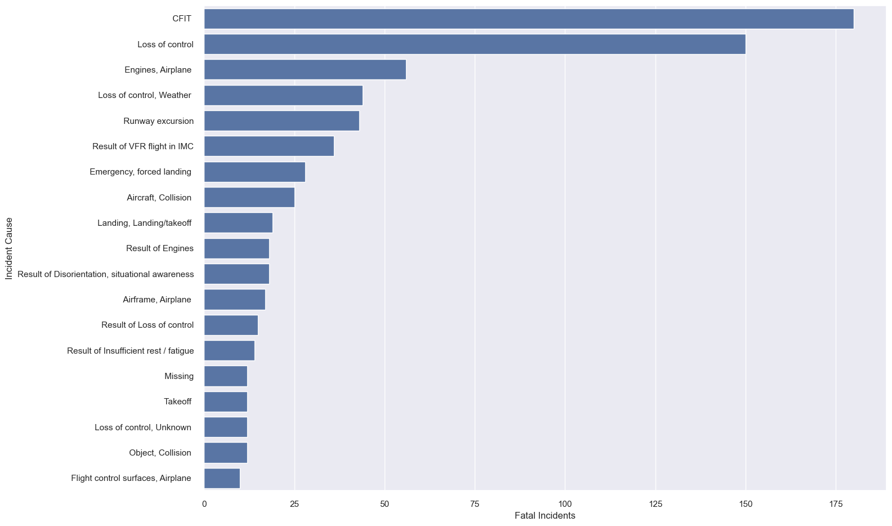
Appendix

